Slide 1
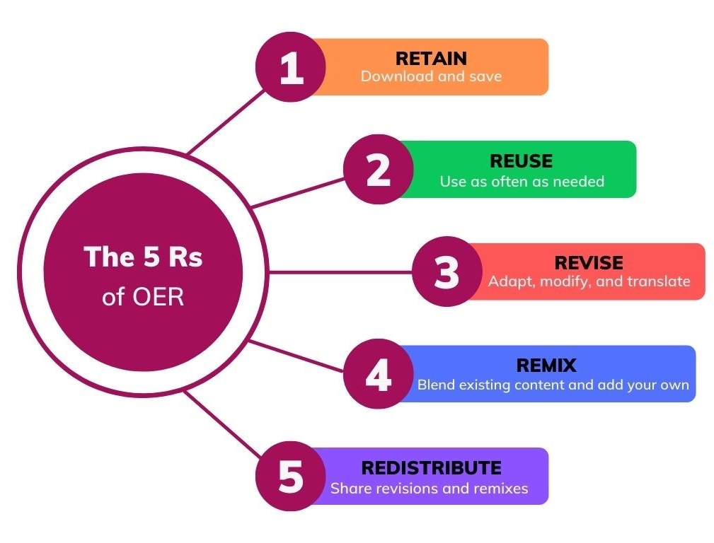


Open Educational Resources (OER)
What is an OER?
An open educational resource can be a textbook, a course, a video, a podcast, a simulation, a case study, or any other learning materials available openly.
What differentiate an OER from other digital resources is that it can be widely distributed and adapted because it is free and not subject to the usual copyright restrictions. This openness is most often indicated by a Creative Commons licence.
What can be done with an OER?
D. Wiley, “Defining the ‘Open’ in Open Content and Open Educational Resources,” Improving Learning, CC BY 4.0. Definitions adapted from SUNY OER Services, “5Rs of OER” [Infographic], CC BY 4.0.
This document is made available under a Creative Commons Attribution 4.0 International licence.

Slide 2

Open Educational Resources (OER)
Why use and create OER?
Wish your current materials were a better fit with the course’s learning outcomes?
Want to contribute to easing the financial burden of higher education for students?
Have you created course content that you wish could be used more widely, but is unlikely to be published as a commercial resource?
Unable to find resources in French adapted to francophone minority contexts?
Is it difficult to find resources for your course because the commercial market is too small for the topic and perspectives you are teaching?
Want to give your students the opportunity to contribute to the creation of knowledge with a renewable assignment?
If you answered YES to any of these questions, you are ready!
This document is made available under a Creative Commons Attribution 4.0 International licence.

