Slide 1
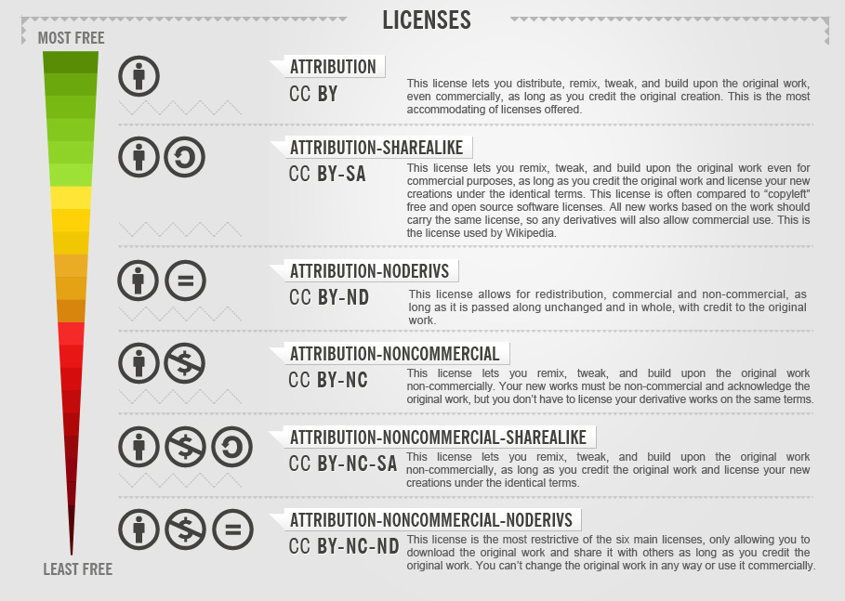




Creative Commons Licences
Foter, “CC License Freedom Scale Chart,” Wikimedia Commons, CC BY-SA 3.0.
The openness of an open education resource is communicated through a Creative Commons licence. These licences act like a permission authorizing the public to share, remix, adapt, and reuse the OER as long as the conditions of the licence are respected.
Resources with the ND condition are technically not OER. ND indicates that the original version cannot be modified to be incorporated into a new resource. This condition goes against two of the five Rs: revising and remixing.
To learn more about open licences and copyright for OER, complete eCampusOntario’s “Open Licensing” module.
This document is made available under a Creative Commons Attribution-ShareAlike 4.0 International licence.

